Slide 1
Agenda
VITA Project Management Class
Work Break Down Structures
Project Schedules
Rev. 10/1/2014
Notes:
Introductions, Name, Agency

Slide 2
Introductions
Name
Agency
Role
Project management experience

Slide 3
Agenda
Work Breakdown Structures
What are they
How to create them, overview
Exercise, creating your own WBS
Why are they important
Creating a Schedule (Component of a Project Plan)
Components of a Project Schedule
Tools & Techniques
How to create them
Overview
Exercise
Review

Slide 4
Class Materials
Laptop
Excel, PowerPoint, Visio, MS Project
Prior or current project
Class is interactive; will create a work breakdown structure, and project schedule

Slide 5
Work Breakdown Structures What are they?
What are they?
A simplified picture, chart, matrix, workflow of the major activities encompassed within the overall project
WBS are intended to;
Provide a jumping off point for the creation of a formal project plan
They allow the project manager and project team to understand the overall effort
They can be an effective means for charting the project course, understanding needed resources, and help to facilitate early project conversations in the initiation and planning phases
Notes:
Have you used them?
When & How?
What are they to you?

Slide 6
Work Breakdown Structures What are they?
PMI’s definition;
“The process of subdividing project deliverables and project work into smaller more manageable components”
“The key benefit of this process is that it provides a structured vision of what has to be delivered”
“The WBS is a hierarchical decomposition of the total scope of work to be carried out by the project team to accomplish the project objectives and create the required deliverables”
“The WBS organized and defines the total scope of the project, and represents the work specified in the current approved scope statement”
“The planned work is contained within the lowest level of WBS components which are called work packages”
“A work package can be used to group the activities where work is scheduled and estimated, monitored, and controlled”
Notes:
PMI’s definition focuses on;
“subdividing”
“structure”
“hierarchical”
“work packages”

Slide 7
Work Breakdown Structures How to create?
When to create a WBS;
PMI has the WBS created in the “Project Management Plan” as part of “Scope Baseline”
Prior to a project schedule
Can be used in a project kickoff meeting
Sometimes created and used as part of the project initiation phase to assist in getting the project approved
Once MS Project schedule and plan are created most PM’s do not maintain the WBS anymore, it becomes part of the project artifacts and archive
PMI suggests that you also create a WBS dictionary as well
Notes:
What are your thoughts on when they should be created?

Slide 8
Work Breakdown Structures How to create?
PMI’s WBS creation guidelines;
What are the Inputs?
Scope management plan
Scope statement
Requirements document
Enterprise environmental factors
Organizational process assets
What are the tools & techniques for creating?
Decomposition
Expert judgement

Slide 9
Work Breakdown Structures How to create?
PMI’s definition of Decomposition
“Technique for dividing the scope, deliverables, and work efforts (major activities) into smaller more manageable and understood parts”
Working steps to perform Decomposition
Identifying the deliverables and related work
Structuring and organizing the WBS
Decomposing the upper WBS levels into lower sub levels
Validating the lower levels have been decomposed sufficiently
Expert judgement is most often used to perform the decomposition
Notes:
Statement - So lets look at Decomposition in greater detail
Question to class – What does decomposition mean to you?

Slide 10
Work Breakdown Structures How to create?
PMI’s definition of a Data Dictionary
Document that provides details around deliverables, activities, and schedule
May include;
Description of work
Assumptions and constraints
Resources
Costs
Acceptance criteria
Technical references
Notes:
How would you describe a data dictionary?

Slide 11
Work Breakdown Structures How to create?
Tools used to create WBS’s
Excel
Visio
Power Point
Word
White board, sticky notes for group sessions
Recommendation
Best way to organize a WBS is by project phase and sequentially
Team meetings with working sessions seems to work best in developing these out
Notes:
What tools would you use to create a WBS?
What's the best way to organize a WBS?

Slide 12
Work Breakdown Structures Why Are They Important?
According to PMI
“it provides a structured vision of what has to be delivered”
“organizes and defines the total scope of the project”
“planned work is contained within the lowest level of WBS components”
Other reasons?
Keeps project focused
Provides for clarity of effort
Provides for transparency
Provides the ability to understand what exactly you need to deliver

Slide 13
Work Breakdown Structures How to create?
Examples

Slide 14
Work Breakdown Structure Example

Slide 16
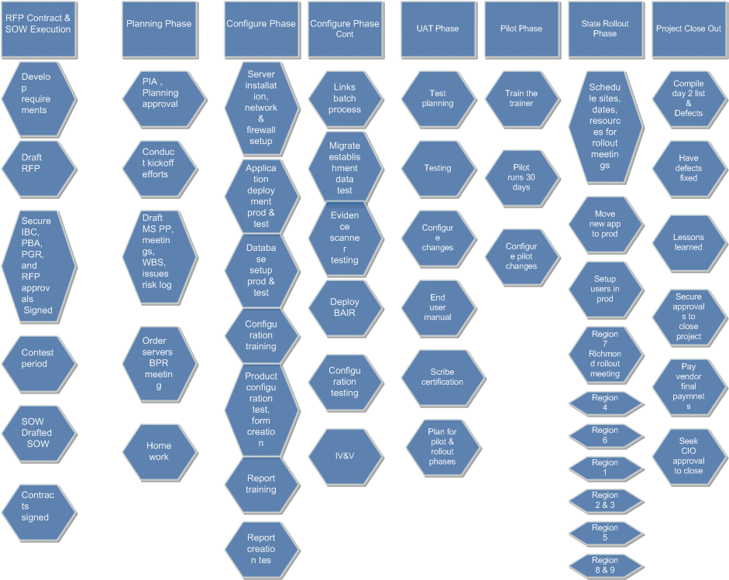
Work Breakdown Structure Example

Slide 18
Project – Timeline/WBS
2014
2015
January - March
April - June
July - September
October - December
January - March
April ..
RFP Contract & SOW Execution
Planning Phase
Configure Phase
UAT Phase
Pilot Phase
State Rollout Phase
RFP Contract & SOW Execution
Develop requirements
Draft RFP
Secure IBC, PBA, PGR, and RFP approvals
Contracts signed
Contest period
SOW Drafted
SOW Signed
Planning Phase
PIA , Planning approval
Conduct kickoff efforts
Draft MS PP, meetings, WBS, issues risk log
Order servers
BPR meeting, homework
Configure Phase
Server installation, network & firewall setup
Application deployment prod & test
Database setup prod & test
Configuration training
Product configuration test, form creation
Report training
Report creation test
Links batch process
Migrate establishment data test
Evidence scanner testing
Deploy BAIR
Configuration testing
UAT Phase
Test planning
Testing
Configure changes
End user manual
SCRIBE Certification
Pilot Phase
Train the trainer
Pilot runs 30 days
Configure changes
State Rollout Phase
Schedule sites, dates, resources for rollout meetings
Move new application to production
Setup users in production
Region 7 Richmond rollout
Region 4
Region 6
Region 1
Region 2 & 3
Region 5
Region 8 & 9

Slide 19
Timeline/WBS
2013
2014
2015
Aug-Dec
January - March
April - June
July - September
October - December
January - March
April ..
RFP Contract & SOW Execution
Planning Phase
Configure Phase
UAT Phase
Cut Over
Pilot Phase
State Rollout Phase
RFP Contract & SOW Execution
Contracts signed
Contest period
SOW Drafted
SOW Signed
Planning Phase
Conduct kickoff efforts
Draft MS PP, meetings, WBS, issues risk log
Order servers
BPR meeting, homework
Configure Phase
Server installation, network & firewall setup
Application deployment prod & test
Database setup prod & test
Configuration training
Product configuration test, form creation
Report training
Report creation test
Links batch process
Migrate establishment data test
Evidence scanner testing
Deploy BAIR
Configuration testing
UAT Phase
Test planning
Testing
Configure changes
End user manual
SCRIBE Certification
Pilot Phase
Train the trainer
Pilot runs 30 days
Configure changes
State Rollout Phase
Schedule sites, dates, resources for rollout meetings
Move new application to production
Setup users in production
Region 7 Richmond rollout
Region 4
Region 6
Region 1
Region 2 & 3
Region 5
Region 8 & 9
Notes:
Provide paper slides & give presentation to class

Slide 20
Project – Timeline/WBS – Another Variation
2014
2015
January - March
April - June
July - September
October - December
January - March
Initiation Phase
Planning Phase
Construct Phase
Deplo
Cut-Over
Closing Phase
Initiation Phase
Create Scope statement
Obtained JC state contract renewal
Lineup vendor and resources
Agency approval received to begin project
Planning Phase
Kick off project
Obtain procurement PO
Develop Server requirements
Develop Application upgrade req
Order Servers
Order desk tops
Create project artifacts & plan
Create requirements
Requirements approved
Construct Phase
Stand-up server
Desktops on site
Re-Image desk tops W7x64
JC site survey
Change server name from P2000 to ABCP2000
Architecture diagram
Create Firewall rules
Deployment Phase
Domain change from abc to cov
Load application on servers
NG enable networking, IP addresses, ….
Fix Sonny’s lap top reports
Load client software on 3 desk tops & Sonny’s laptop
Connecting existing printer for id badges
JC testing
Create plan for cutover
Cut Over Phase
Transfer over data base
Enable audible alerts on desk tops
Enable non sleeping PC’s
JC test entire system
User signoff
Closing Phase
Sun-set ABC domain

Slide 21
Work Breakdown Structures
Exercise

Slide 22
Create Your Own WBS Exercise
Create groups or Go Solo
Use a project you are familiar with or choose a life event
Party
Wedding
Vacation
Home improvement project
Buying a car or house
Create in either excel, Visio, PowerPoint, or word
Organize by project phases;
Ideation
Initiation
Planning
Discovery
Construct/Execution
System Test
UAT
Pilot
Deployment
Rollout
Close
Notes:
Group exercise, 4 to a group, okay to work on there own

Slide 23
Project Schedules

Slide 24
Project Schedules Definition & Characteristics
According to PMI;
“…the process of analyzing activity sequences, durations, resource requirements, and schedule constraints to create the project schedule model.”
Characteristics of a schedule
Iterative process
Starts with a draft
PM seeks to evolve to a baseline schedule
Developed during the planning phase used through all phases
Keeps team aligned, focused, and provides for transparency
Notes:
What does a schedule mean to you?

Slide 25
Project Schedules Time Management
Time Management (PMI)
PMI section devoted to managing time, schedule is part of that.
“the processes to manage the timely completion of the project”
Time Management Processes
Define activities
Sequence activities
Estimate resources
Develop schedule
Monitor & control schedule
Notes:
So basically a schedule enables time management
Lets look at “Time Management”

Slide 26
Project Schedules Sources\Inputs\Contributors
Sources\Inputs\Contributors
Project scope statement
Work breakdown structure
Charter
Requirements document
Organizational culture & structure
Resource availability
Project management software
Templates
Organizational PMO’s; governance processes, tools templates
SME meetings
Expert judgement
Prior projects of similar size, scope, duration, budget, and lessons learned from prior projects
Issues and risks log
Vendor inputs
Notes:
Can you identify some sources or artifacts that can be used to help create a schedule?
Do you agree with these, are there anymore?

Slide 27
Project Schedules Approaches/Methods For Creating
Decomposition (PMI)
Technique for dividing and subdividing scope and deliverables into small parts.
Essentially breaking down work packages to their individual activities needed to deliver the work package
Rolling Wave (PMI)
An iterative planning technique that greatly details near term work and summarizes future planned work at a high level
Schedule then contains varying levels of detail based on when they occur
As the project progresses short term activities are closed out and the long term activities become detailed, resourced, scheduled, and monitored & controlled
Expert Judgement
Project team members, SME’s, PMO, other project managers, Business teams; develop and provide for input into the defining of activities, there sequence, duration, dependency's, and resources
Notes:
Can you name a few approaches to creating a schedule?

Slide 28
Project Schedules Important Attributes
The following attributes are important to know in order to create quality schedules;
Activities
Milestones
Sequencing
Dependencies, Predecessors
Estimating time, durations
Estimating resources
Critical path
Compression

Slide 29
Project Schedules Activities & Milestones
What's the difference between Activities and Milestones?
Activities
Are distinct from milestones
Have durations, resources, and costs assigned to them
Milestones
Is a significant point in time, or event in a project
They have 0 duration because they represent a point in time (PMI)
In reality they may have durations if the milestones is also a tollgate that requires reviews and approvals or can be a block of events like a rollout, deployment, …
Notes:
What's an activity?
What's a milestone?
Are they different?

Slide 30
Project Schedules Sequencing Method
Types of Sequencing for Activities in a Schedule
Finish to start – one must finish before another can start
Finish to finish – one must finish before another can finish
Start to start – one must start before another can start
Start to finish – one cannot finish until another has started
PMI calls these;
Precedence Diagram Method (PMI)
Looks at the relationship between the sequence of activities (my definition)
Notes:
So with a schedule its real important to get the activities and milestones in the correct order, PMI provides for a methodology to perform this.

Slide 31
Project Schedules Sequencing – Dependency’s
Types of dependencies
Those that are contractually required, physical limitations, and legally required
Best practices, a desire for a specific sequence
Some relationship exists between the project and an external factor
Some factor inside the project teams control
Notes:
What types of dependency's are there?

Slide 32
Project Schedules Estimating Activity Resources
Definition of Estimating Activity Resources (PMI)
“…process of estimating the type and quantities of material, human resources, equipment, or supplies required to perform each activity.”
Possible Contributors/Inputs
WBS
Activity list
Requirements documents
Subject mater experts
Prior project artifacts, lessons learned
Resource calendars
Organizational factors, culture, resource locations
Project team
Notes:
What do you think would help to provide details around estimating resources?

Slide 33
Project Schedules Estimating Activity Resources
Tools & techniques
Expert judgement
Published data; rates, unit costs, industry standards and practices
Bottom up estimating
Project management software
Meetings with project team and SME’s
Review of prior project artifacts
Notes:
What tools & techniques do you use?
Which ones are the best?

Slide 34
Project Schedules Estimating Activity Durations
Estimating Activity Durations (PMI)
“…the process of estimating the number of work periods needed to complete individual activities and estimated resources.”
Possible Contributors/Inputs
WBS
Activity list
Risks
Requirements documents
Subject mater experts
Prior project artifacts, lessons learned
Prior projects schedule
Resource calendars
Organizational factors, culture, resource locations
Notes:
What inputs do you use in estimating durations?

Slide 35
Project Schedules Estimating Activity Durations
Tools & techniques, approaches, methodology (PMI)
Analogous estimating – using historical data
Parametric – use of an algorithm on historical data
3 point
Most likely
Optimistic
Pessimistic
Group decision making
Expert judgement
Notes:
Which ones do you use?
Which is the best?
Why?
Which one don’t you use?
Why?

Slide 36
Project Schedules Critical Path
PMI’s definition
“The critical path is the sequence of activities that represents the longest path through a project, which determines the shortest possible duration”
It’s also come to mean;
Most important set of activities
Sequence of activities that cannot have any delays

Slide 37
Project Schedules Changes, Compression
Compression (PMI)
Shortening the schedule when needed while keeping the same scope
Methods of Compressing a schedule;
Crashing
Adding resources
Paying for overtime
Hiring contractors
Paying time performance bonuses
Fast tracking
Moving up activities that are normally done in sequence or beginning activities earlier
Notes:
So what happens when you need to shorten a schedule?

Slide 38
Project Schedules Examples
Notes:
Schedule should be organized around a central structure; I like by phase
Open full schedule

Slide 39
Project Schedules Examples
Notes:
2nd example

Slide 40
Exercise Create a Project Schedule
Use a project you are familiar with or choose a life event
Party
Wedding
Vacation
Home improvement project
Buying a car or house
Create in MS Project or in Excel than import into MS Project
Organize by some logical grouping of activity
Recommend by project phase
Include;
Task name
Duration
Start, Finish
Predecessor
Resource

Slide 41
Review Questions
What are WBS’s?
A simplified picture, chart, matrix, workflow of the major activities encompassed within the overall project
What are WBS intended to do?
Provide a jumping off point for the creation of a formal project plan
They allow the project manager and project team to understand the overall effort
They can be an effective means for charting the project course, understanding needed resources, and help to facilitate early project conversations in the initiation and planning phases

Slide 42
Review Questions
When do you create a WBS?
PMI has the WBS created in the “Project Management Plan” as part of “Scope Baseline”
Prior to a project schedule
Can be used in a project kickoff meeting
Sometimes created and used as part of the project initiation phase to assist in getting the project approved
What are the Inputs to a WBS?
Scope management plan
Scope statement
Requirements document
Enterprise environmental factors
Organizational process assets

Slide 43
Review Questions
What are the techniques for creating a WBS?
Decomposition
Expert judgement
Why are WBS important?
Organizes and defines the total scope of the project
Keeps project focused
Provides for clarity of effort
Provides for transparency
Provides the ability to understand what exactly you need to deliver

Slide 44
Review Questions
What are some inputs that can be used to create a project Schedule?
Project scope statement
Work breakdown structure
Charter
Requirements document
Organizational culture & structure
Resource availability
Organizational PMO’s; governance processes, tools templates
SME meetings
Expert judgement
Prior projects of similar size, scope, duration, budget, and lessons learned from prior projects
Issues and risks log
Vendor inputs

Slide 45
Review Questions
What are some methods to creating a project schedule?
Decomposition (PMI)
Rolling Wave (PMI)
Expert Judgement
What's the difference between an Activity and a Milestone?
Activities
Have durations, resources, and costs assigned to them
Milestones
Is a significant point in time, or event in a project
They have 0 duration because they represent a point in time (PMI)

Slide 46
Review Questions
What are the important components of a good project schedule?
Activities are grouped together by some sort of logical order, recommend phases
Activities are sequenced
Start dates and end dates are noted
Resources are assigned to each activity
Predecessors are identified
Milestones are noted
Critical path is identified
Schedule is vetted and approved by the project team, sponsor, and leadership group
Schedule is maintained, transparent, and considered a living document through the life of the project

Slide 47
Questions?

