Slide 1
Successful Stakeholder Management

Slide 2
Stakeholder
A stakeholder is a person, group of people, or an organization involved in the project, or they may be affected by the project or its outcome.

Slide 3
A stakeholder can be:
Stakeholders:

Slide 4
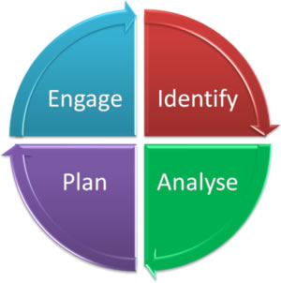
Stakeholder Model

Slide 5
A internal stakeholder can be:
Project Sponsor
Project team
Senior management
Training department
Business units
Procurement Personnel
End user of the project’s outcome

Slide 6
A external stakeholder can be:
Vendors
General public
Government/Regulators
Press/Media
Grant Administrator
Consumer Advocacy Groups

Slide 7
In general - A stakeholder can be:
Someone affected by the project, or the
project’s outcome
Someone who has any kind of interest in the
project, or the project’s outcome

Slide 8
Project Success
Stakeholders are individuals and organizations that have a vested interest in the success of the project. The identification and input of stakeholders help to define, clarify, drive, change, and contribute to the scope and, ultimately, the success of the project.

Slide 9
Project Success
To ensure project success, the project management team needs to identify stakeholders early in the project, determine their needs and expectations, and manage and influence those expectations over the course of the project.

Slide 10
Identify Stakeholder
To complete your project successfully, it’s very critical for you to identify your project’s stakeholders, their needs, requirements, expectations, group, interests, power, influence, and everything that you can find out at very initial stage of the project.

Slide 11
Identify Stakeholder
Identifying the stakeholders is an iterative process, and stakeholders must be identified throughout the project life cycle.
Stakeholder Analysis Video: Stakeholder Management and Power Interest Grid Example
MindToolsVideos
https://www.youtube.com/watch?v=fbUM12IiGms&feature=player_embedded

Slide 12
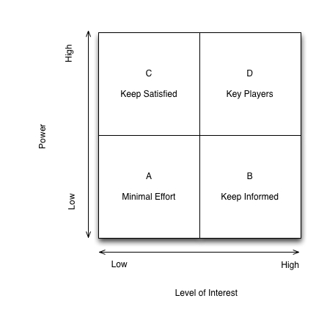
Stakeholder Matrix (Classification)
Stakeholders can be classified based on their power and interest, power and influence, influence and impact, and power, urgency and legitimacy
Among all, power and interest classification is the most widely used to classify the stakeholders.

Slide 13
Stakeholder Matrix (Classification)
There are various ways and different classification models in which you can classify and analyze the project stakeholders.

Slide 14
Stakeholder Matrix (Classification)
As you can see from the exhibit, you can group all stakeholders into four groups. The strategy to manage them is as follows:
Stakeholders with high power and high interest should be managed with utmost care
Stakeholders with high power and low interest should be kept satisfied
Stakeholders with low power and high interest should be kept informed
Stakeholders with low power and low interest require less effort than the rest. They should only be monitored
As a project manager, it is your job to keep looking at each stakeholder because you never know when a low power stakeholder will become high power and influential.

Slide 15
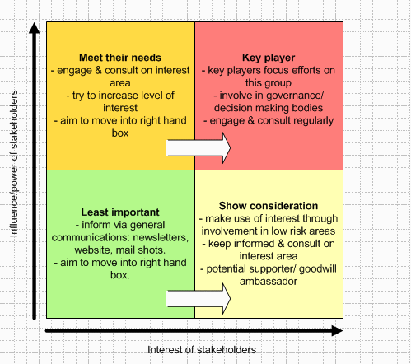
Stakeholder Matrix (Classification)
Power versus interest grid adapted from Eden and Ackermann (1998: 121-5, 344-6).

Slide 16
Stakeholder Register
A Stakeholder Register is a project management document, which contains the information about all project stakeholders. It identifies and lists the people, groups and organizations impacted by the project. In this register you can find every detail about the stakeholders including their names, titles, role, interests, power, requirements, expectations, and influence to affect any project objective and many more things.

Slide 17
Stakeholder Register
The Stakeholder Register usually contains the three types of information — stakeholder identification information, assessment information and their classification.

Slide 18
A Stakeholder Register may have following information:
What is the name of the stakeholder?
What is the title held by the stakeholder?
What is the role of stakeholder in the project and/or in the organization?
What is the contact information of the stakeholder?
What are his requirements from the project?
How do the stakeholders like to communicate?
How often would the stakeholder like communicate?
What are his expectations from the project?
How can he influence the project?
How about his interest, whether it is high, medium, or low?
Classification information

Slide 19
Sample – Stakeholder Register

Slide 20
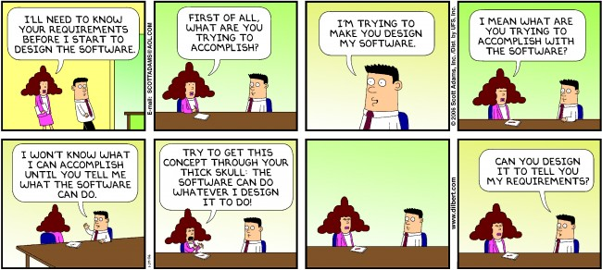
Stakeholder

Slide 21
“Food For Thought”
Quality is a shared responsibility of all project stakeholders. Quality is not just a review at the completion of a deliverable. Quality is built into the project from the beginning by support from stakeholders as each phase of the project is executed. Appropriate stakeholders will participate in the creation and/or review of all deliverables.

Slide 22
Q & A

